Slide 1
Effective Bereavement Support for Vulnerable Population Groups
Created By Red Nose
Presented by:

Slide 2








What we be discussing today
About Red Nose Grief and Loss Services
Culturally Safe Bereavement Support Resources
Health Service Based Support
Clinical and Patient Resources

Slide 3
About Red Nose
Grief and Loss Services
Notes:
12

Slide 4
Red Nose have been guiding grieving families through their loss for nearly 50 years.
Whilst you cannot take the pain of a loss away, providing culturally sensitive and trauma informed care leads to better outcomes for grieving families.

Slide 5











Grief and Loss Services
Red Nose Provides
x Medicare or x Visa
Confidential
No Medicare card needed or restrictions on vias types.
Our Service is confidential.
x Referral
Free
No referral is needed; parents can access the services directly by phone, email, live chat or our website.
We provide free grief and loss support regardless of when the loss occurred.
Professional &Lived experience
National
The grief and loss support we offer is delivered by professional counselling and specially trained lived experience support staff and workers.
Red Nose is a
national charity.
Notes:
13

Slide 6



The Services and Supports we Provide
  Hospital to Home
Our specially trained lived experience workers provide immediate support within three months of loss.
  Peer Support
This program is available 24/7 to anyone who has been affected by the loss of a pregnancy, stillbirth, death of baby or child. Our team are a mixture of specially trained team members and volunteers.
  Counselling
04
I specially trained grief and loss counsellors work to provide person centered care that is designed around the individual needs of the parent or family unit. Support is not time limited and parents can access as many sessions as they need.
National
Professional &Lived experience
Free
x Medicare or x Visa
Confidential
Access more than one
x Referral
Notes:
13

Slide 7
Culturally Safe Bereavement Support Resources
Notes:
12

Slide 8
Resources Available
Red Nose has co-designed a suite of videos and resources to support clinical staff in providing culturally safe bereavement care, from the time of a loss through to connecting families with effective, culturally safe bereavement support services.
Using a co-design model, Red Nose has created content to support several vulnerable population groups, including:
  First Nations peoples
  Culturally and Linguistically Diverse (CALD) communities
  Refugee and Migrant families
  Rural and Remote populations
  Young Mothers

Slide 9
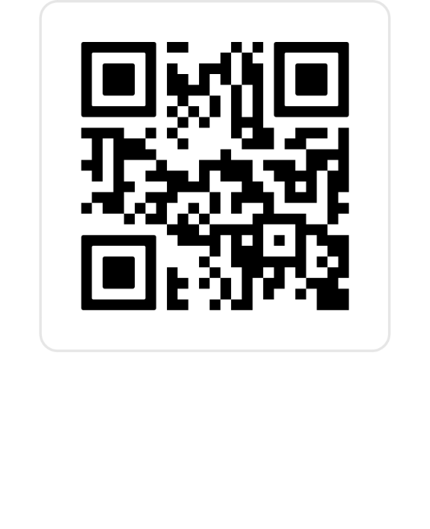
Video Resources
Red Nose has created a series of seven Co-designed bereavement support videos.
These videos are:
Preparing for the Conversation with Grieving Parents
Self-Care for Health Professionals
Supporting Young Mums
Supporting Rural and Remote Families
Supporting Refugee, Migrants & CALD Communities in Times of Grief
Supporting First Nations Families & Communities in Times of Grief
Handover for Continuity of Bereavement Support

Slide 10
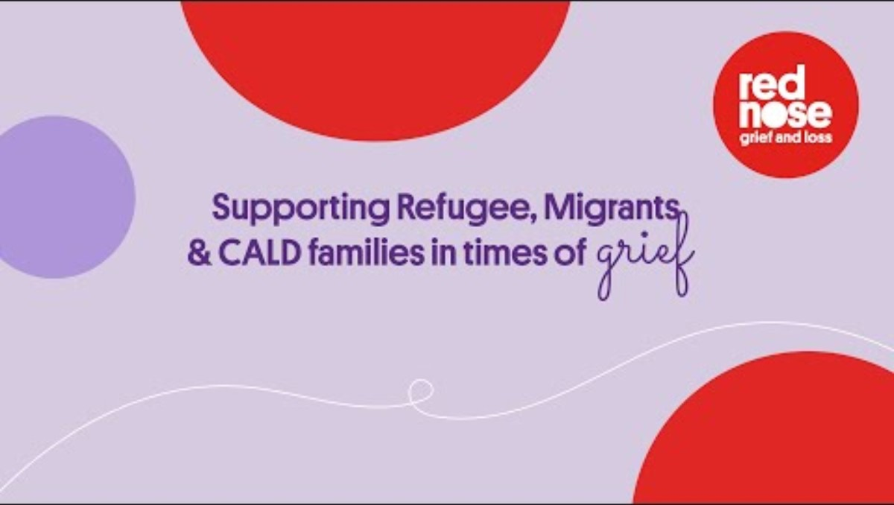
Share a Video …
Notes:
This slide is to be used if you like to share one of the videos with you team

Slide 11
Clinical and Patient Resources
Red Nose has co-designed a suite of additional resources to assist clinical staff in providing culturally safe and supportive care, and to help them feel confident in the care they deliver.
Notes:
12

Slide 12

Supporting Resources: For You
Post Care Guidelines,
  Easy to access and implement guides for clinical staff to provide culturally safe care
Red Nose Clinical Information Guide
  This brochure provides clinical staff with key information on what services Red Nose provides to support in follow up care conversations.
Clinical Debriefing
  Clinical staff can access Red Nose by calling Red Nose’s intake team on 1300 308 307 or emailing intake@rednose.org.au

Slide 13
Supporting Resources: For Patients
Red Nose Patient Service Postcards
  Key service information to reduce information overload
  Translated into multiple languages and First Nation appropriate
  Information for dads on supports
Birth Cards
  Created for Pre and Post 20 weeks
  Ethnic minority suitable cards where name is not recorded
  First Nations appropriate cards
Referral Information
Referral flyer to provide patients with key information on their referral to Red Nose Grief and Loss Services
  Available in 10 languages
  First Nations appropriate information

Slide 14
Hospital Based Support
Notes:
12

Slide 15
Health Service Policies and Guidelines
USE THIS SLIDE TO ADD:
  Local policies and procedures
  Cultural safety frameworks
  Internal contacts to support patients i.e. AHLO, social work team

